Slide 1
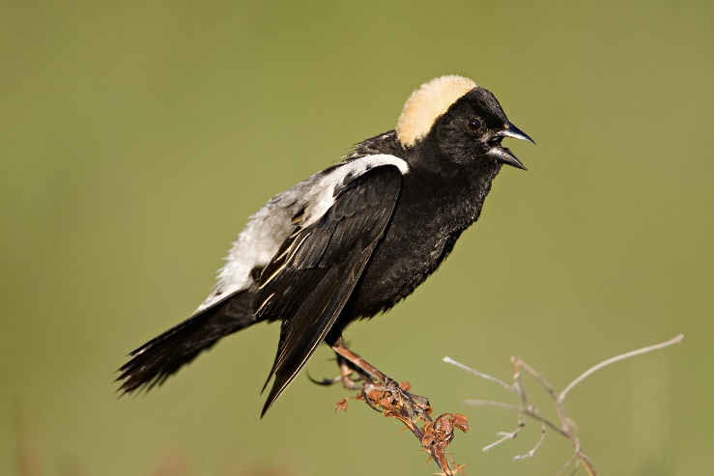
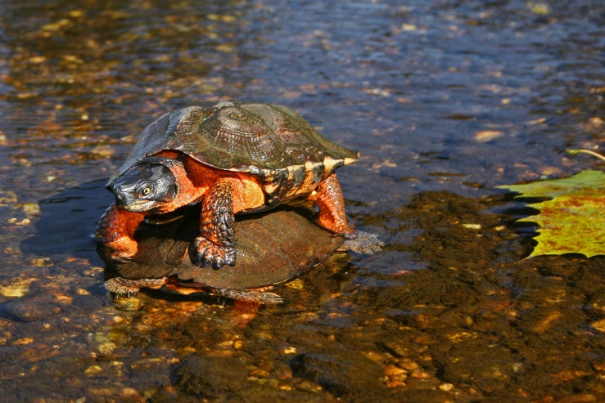
The ELM Management Dilemma
Manage for bobolinks:
Maintain the meadow by mowing once a year, late in the season
Will kill wood turtles if they are in the field
To manage for wood turtles:
Do not mow during their active period (Apr-Oct)
Goldenrod will produce their seed set and continue to dominate the field and spread
??

Slide 2
What direction to take?
What are RGT’s objectives for ELM management?
Possibilities:
Manage according to conservation value: wood turtles
Manage for bobolinks/biodiversity: wildlife-oriented disturbance
Manage for human interests (e.g. beauty): frequent mowing
NOT mutually exclusive

Slide 3
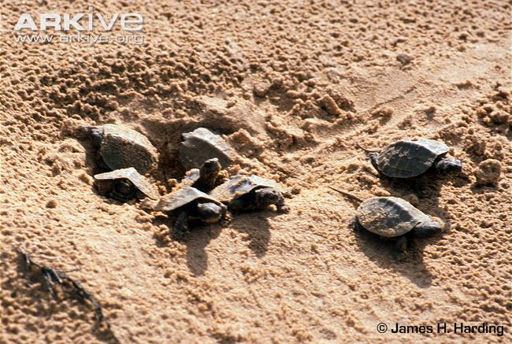
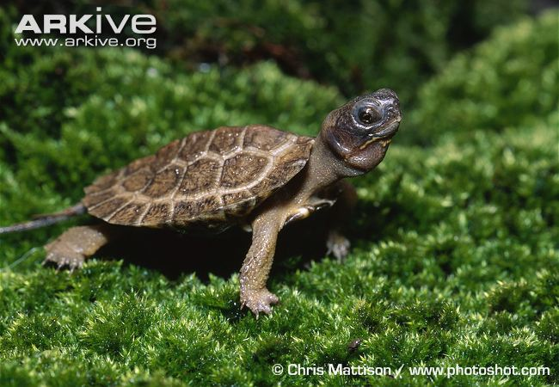
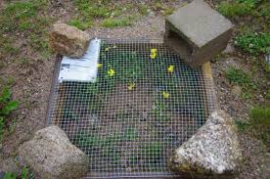
1. Manage for Wood Turtles
Actively participate in enhancing ELM as wood turtle habitat
Create sandy areas near the water for nesting
Create edge habitat that allows for easy thermoregulation, protection from predators, and foraging
Protect nests?
Systematically monitor the population
Always good to have an understanding of the population you are managing for
Contributing to state-wide effort to study and protect the population
Refrain from mowing from Apr-Oct

Slide 4
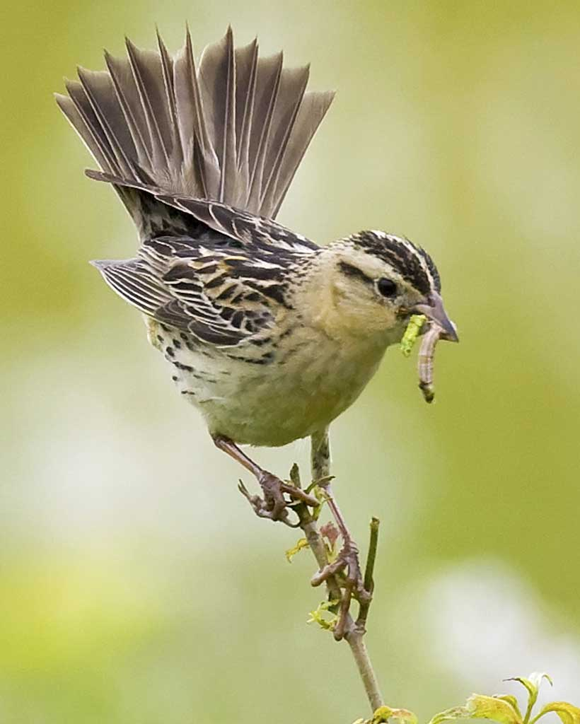
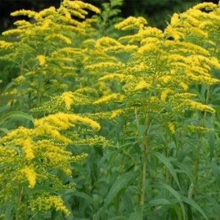
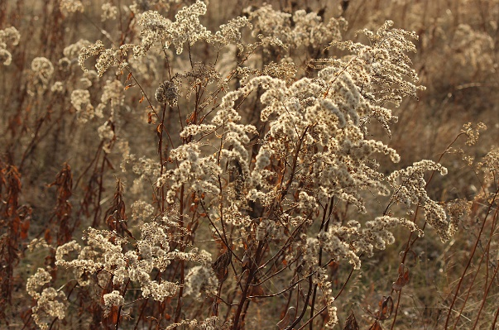
2. Manage for Bobolinks
Disturb the meadow
Late enough that nestlings can fledge and learn to fly
Early enough that goldenrod does not form seed set
Initially, mowing twice a year may be necessary set back goldenrod
Earlier the better for 1st mowing (renesting likely if mowed before June 20)
Alternative: complete restoration
Till and plant warm-season grasses
Continue to survey bobolink population

Slide 5
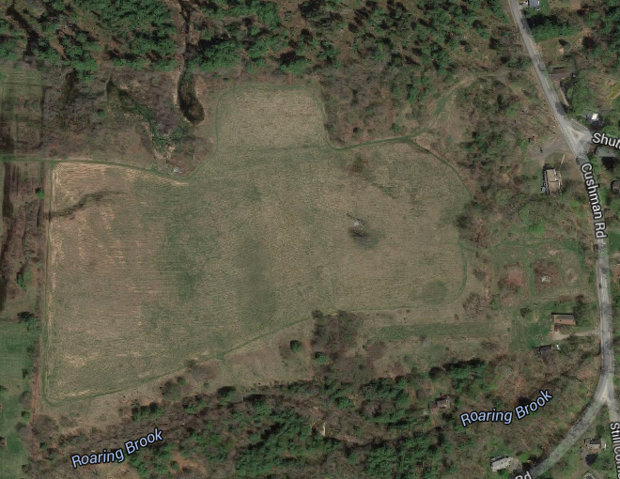
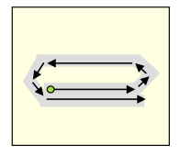
2. Manage for Bobolinks
Altering mowing techniques MAY decrease mortalities
Raise the blade height >7 inches (higher the better)
Sickle bar mowers are better (hard to find)
Mow slowly
Leave an unmowed 30 ft buffer near streams and forest
Start mowing from the location that is least likely to contain turtles

Slide 6
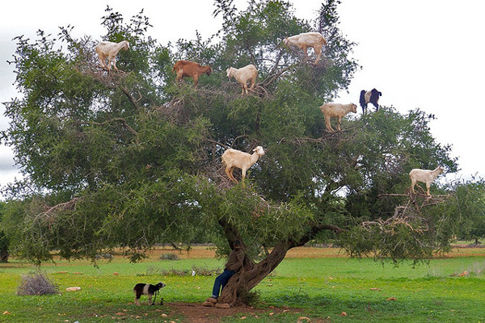
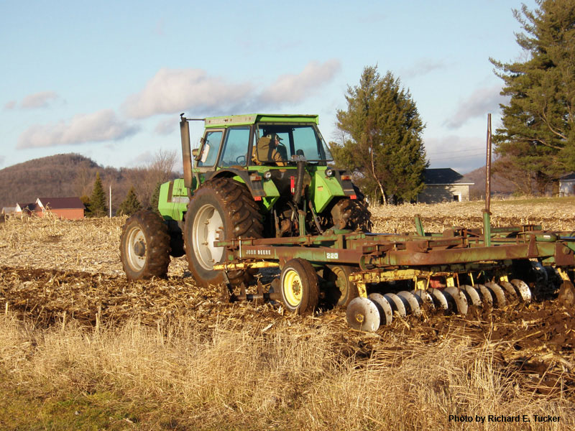
3. Attempt to manage for both
Create turtle habitat, etc
Create bobolink habitat through means other than mowing
Cut goldenrod back with handheld machinery
Light discing during inactive period
MAY allow for reseeding
Try goats again during a different time of year?
Light grazing with a different animal (less expensive)
Remove thatch
Herbicide?

Slide 7
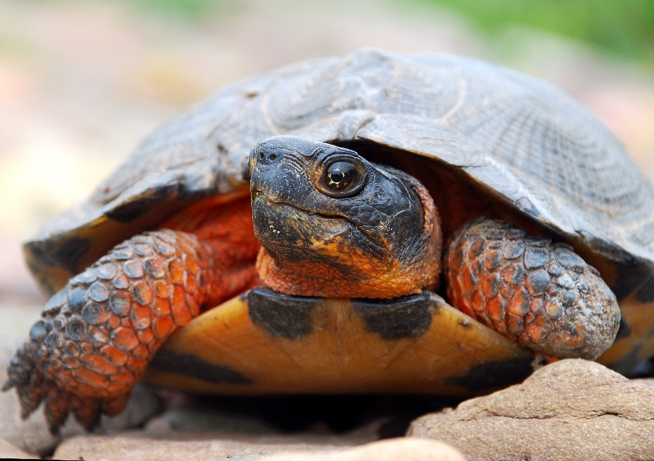
Benefits of Managing for Wood Turtles
1. Protecting a threatened species
(not killing a threatened species)
2. Heightened conservation value
3. RGT can be framed in a new light to the public
Not just conserving land, also actively protecting wildlife
4. State funding?
5. Turtles are awesome!

Slide 8
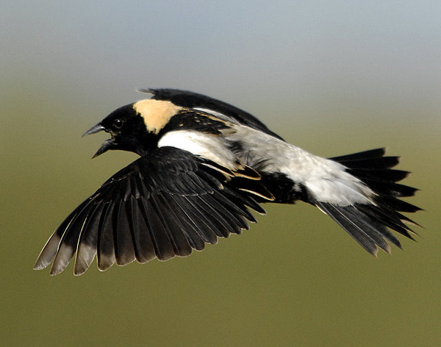
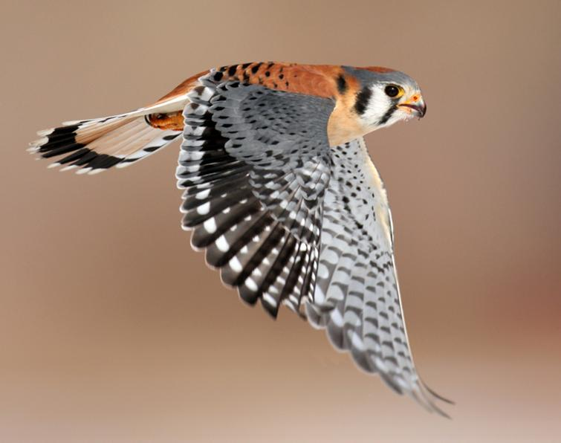
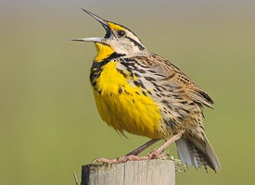
Benefits of Managing for Bobolinks
1. Protecting a declining species
2. Will likely benefit other grassland species
(e.g. kestrel)
3. Aesthetics
4. Potentially attract more people (birders)
5. Birds are awesome!

Slide 9
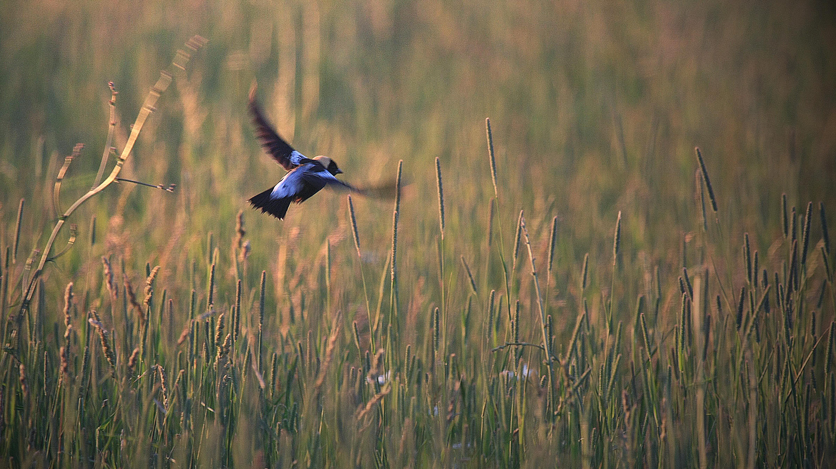
Take Home
Managing for wildlife takes time and patience
Results are not always seen immediately seen
Especially for birds
Cannot manage what you do not know
Consistent, systematic monitoring of ELM’s wildlife will allow you to:
Make informed decisions
Understand the impact of your management decisions

