Slide 1
Management of East Leverett Meadow

Slide 2
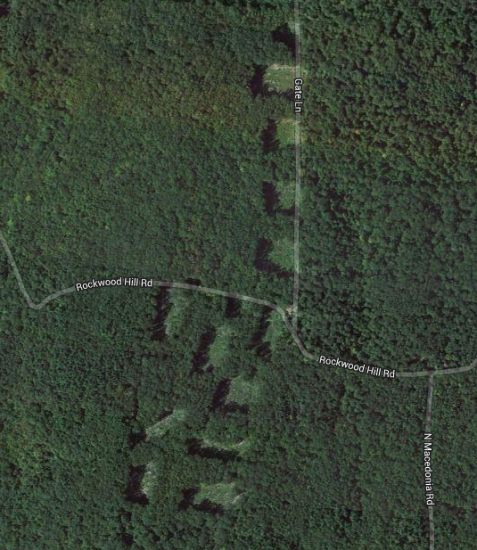
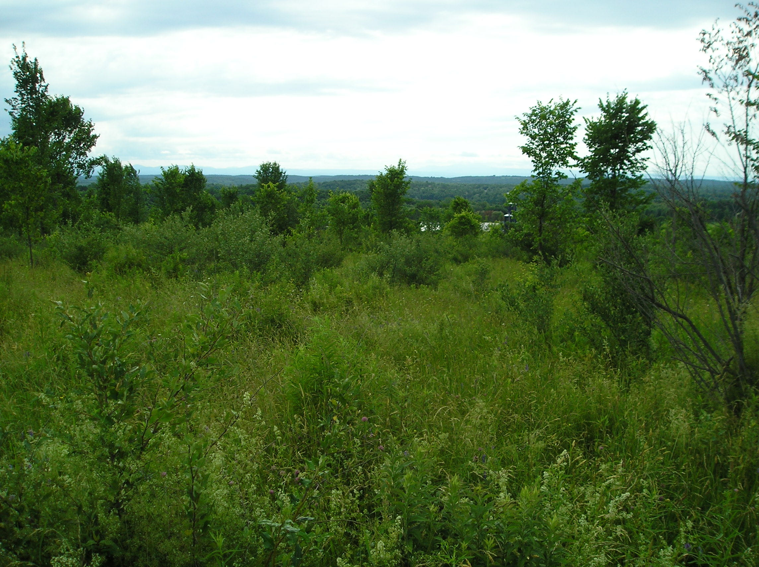
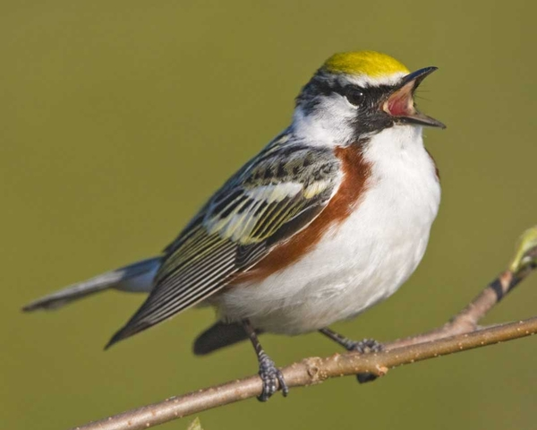
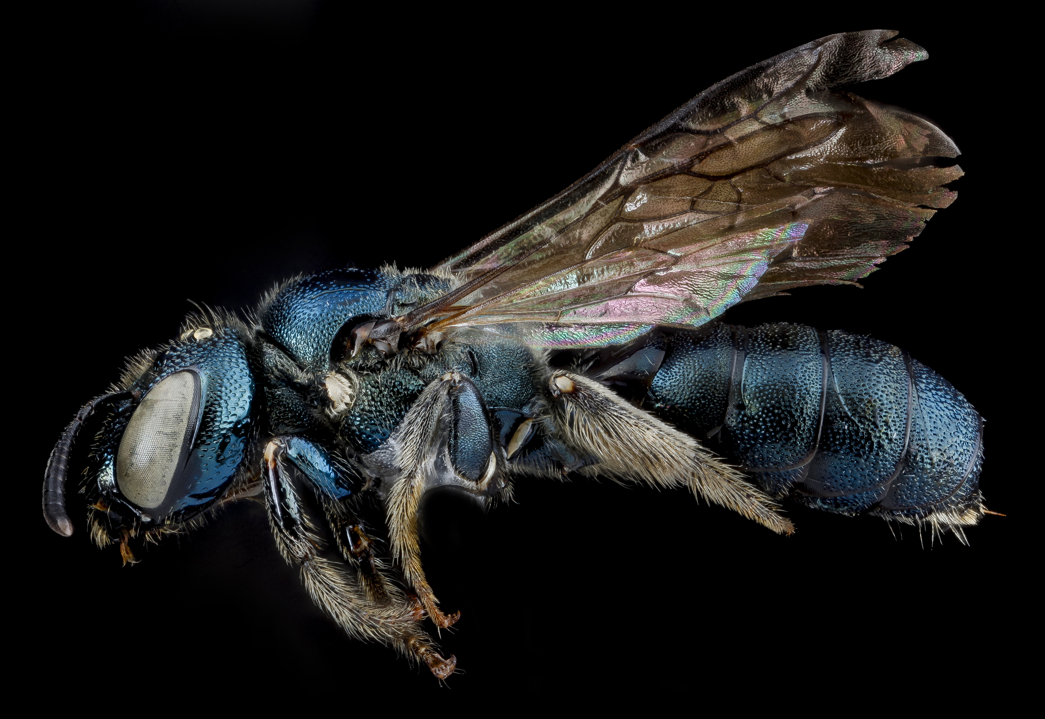
My Background:
Working in wildlife biology since 2011
- Wood thrush telemetry in Leverett
- Snakes and turtles in South Carolina
- Prairie warbler ecology in the Bahamas
Environmental Conservation
- Wildlife conservation and management
Studying the effects of logging on shrubland birds and
native pollinators in western Massachusetts (Quabbin)

Slide 3
How I hope to help
Provide a chronology of significant events related to the management of ELM
Today:
Provide a general summary of the issues with respect to managing ELM
Provide background biology
Present potential management possibilities

Slide 4
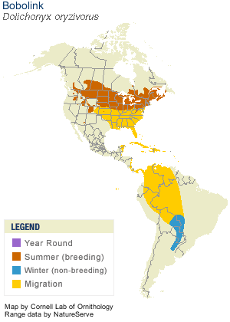
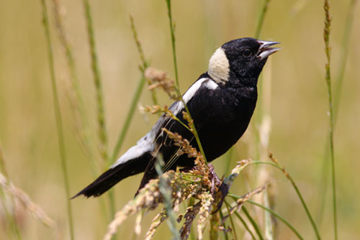
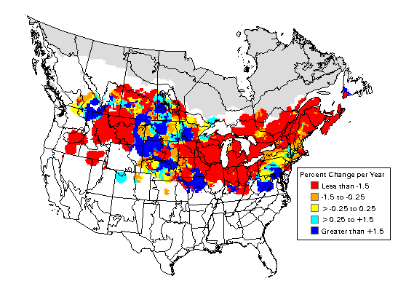
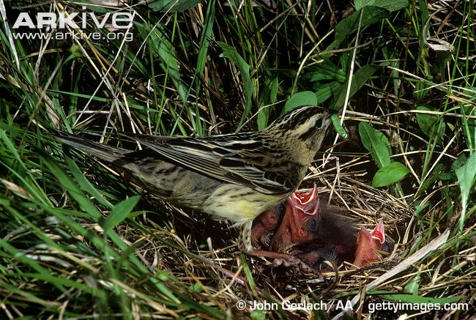
Bobolink
2000: discovered at ELM
Grassland species: needs grassland to breed
Neotropical migrant
Global population has been steeply declining for decades
NOT state-listed
Only grassland obligate species that ELM can support

Slide 5
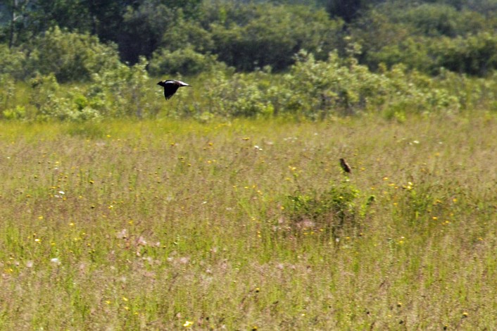
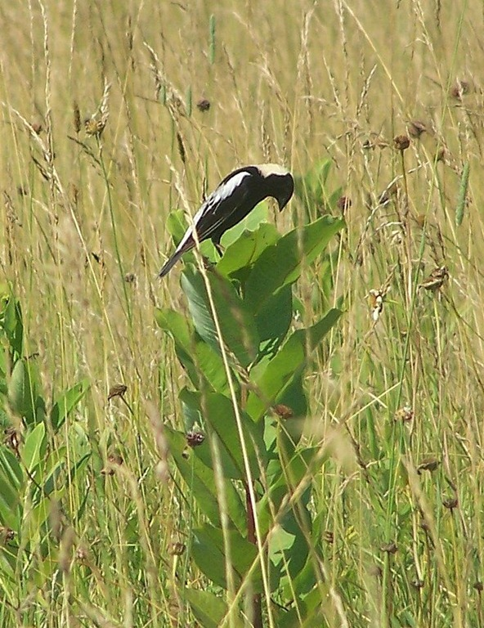
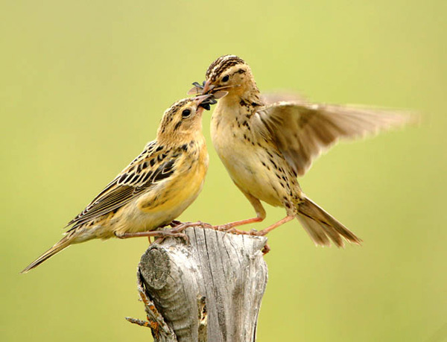
Bobolink
Habitat:
Old fields
Mosaic of vegetation types:
Grass, sedge, scattered broad-leaved forbs, shrubs
Perch structures: posts, shrubs
Taller vegetation
Often moist soil
Forbs are necessary, but too many is bad

Slide 6
Bobolink Management
All properties are different: there is no cure-all
prescription
Typically:
Mow every 1-2 years
Sustains field and keeps back woody vegetation, but infrequent enough to support some forbs
Mow after August 1st
Avoid nestling mortalities
Earlier mowings may be necessary at first to establish the appropriate conditions

Slide 7
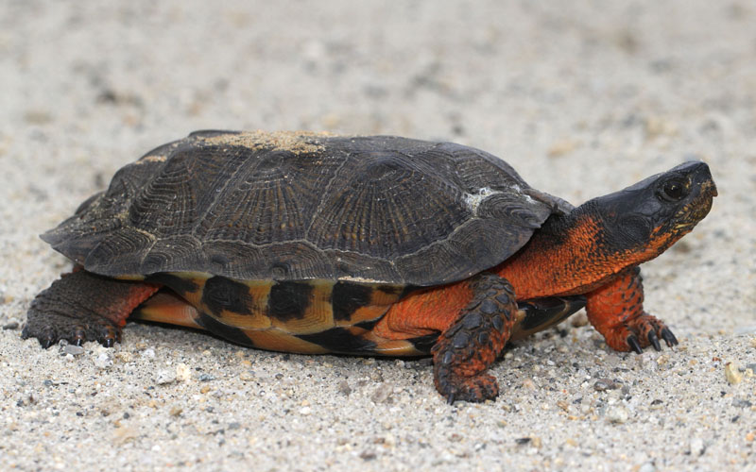
Wood Turtles
Discovered at ELM in 2010
State-listed: special concern
Habitat: aquatic AND terrestrial
Streams used for hibernation and mating
Upland habitats used for foraging and estivation
Prefer edges: a mix of forested and opening habitats

Slide 8
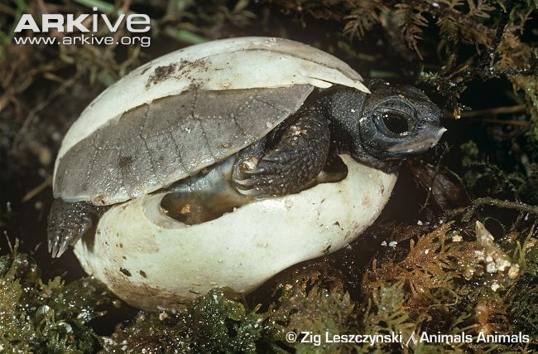
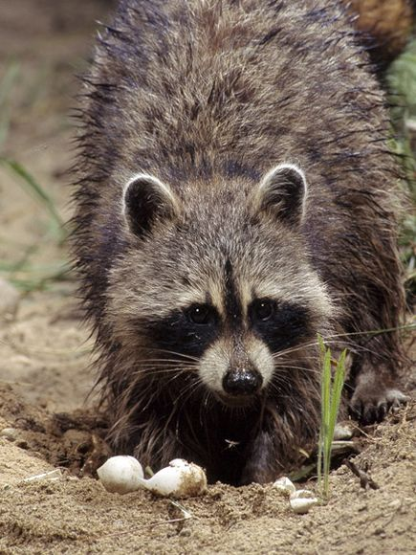
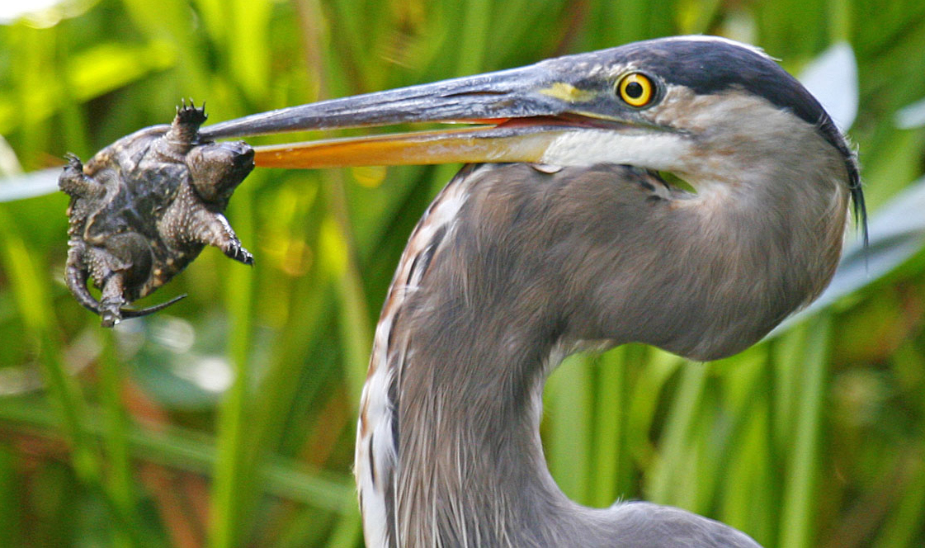
Why are wood turtle populations in such bad shape?
Natural, evolved reproductive strategy makes them vulnerable
Slow to sexual maturity: 14-18 years
Only a single, small clutch size every year (7 eggs)
Extremely low hatch rate (predators)
Very low juvenile survival rate
These challenges are only counteracted by:
Long lifespan (70+ years) and
High adult survival rate (95%)
Even small decreases in adult survival (1-2%) can cause populations to go extinct

Slide 9
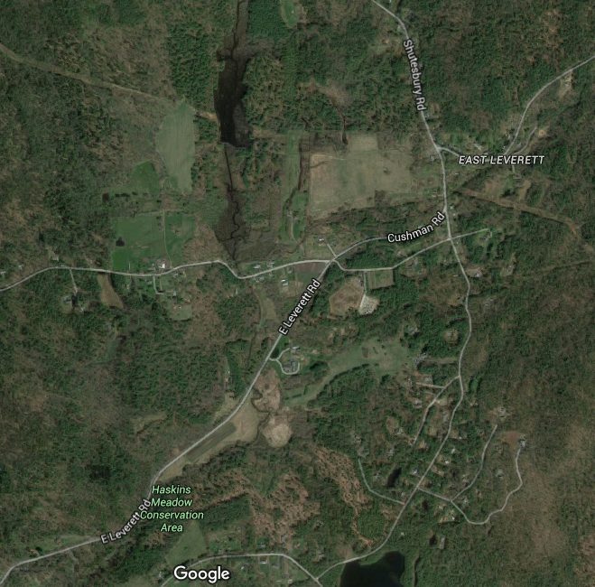
ELM

Slide 10
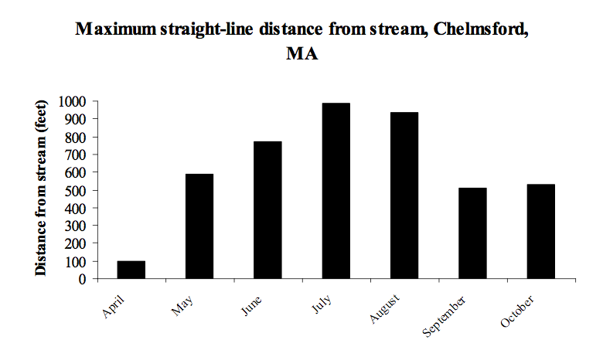
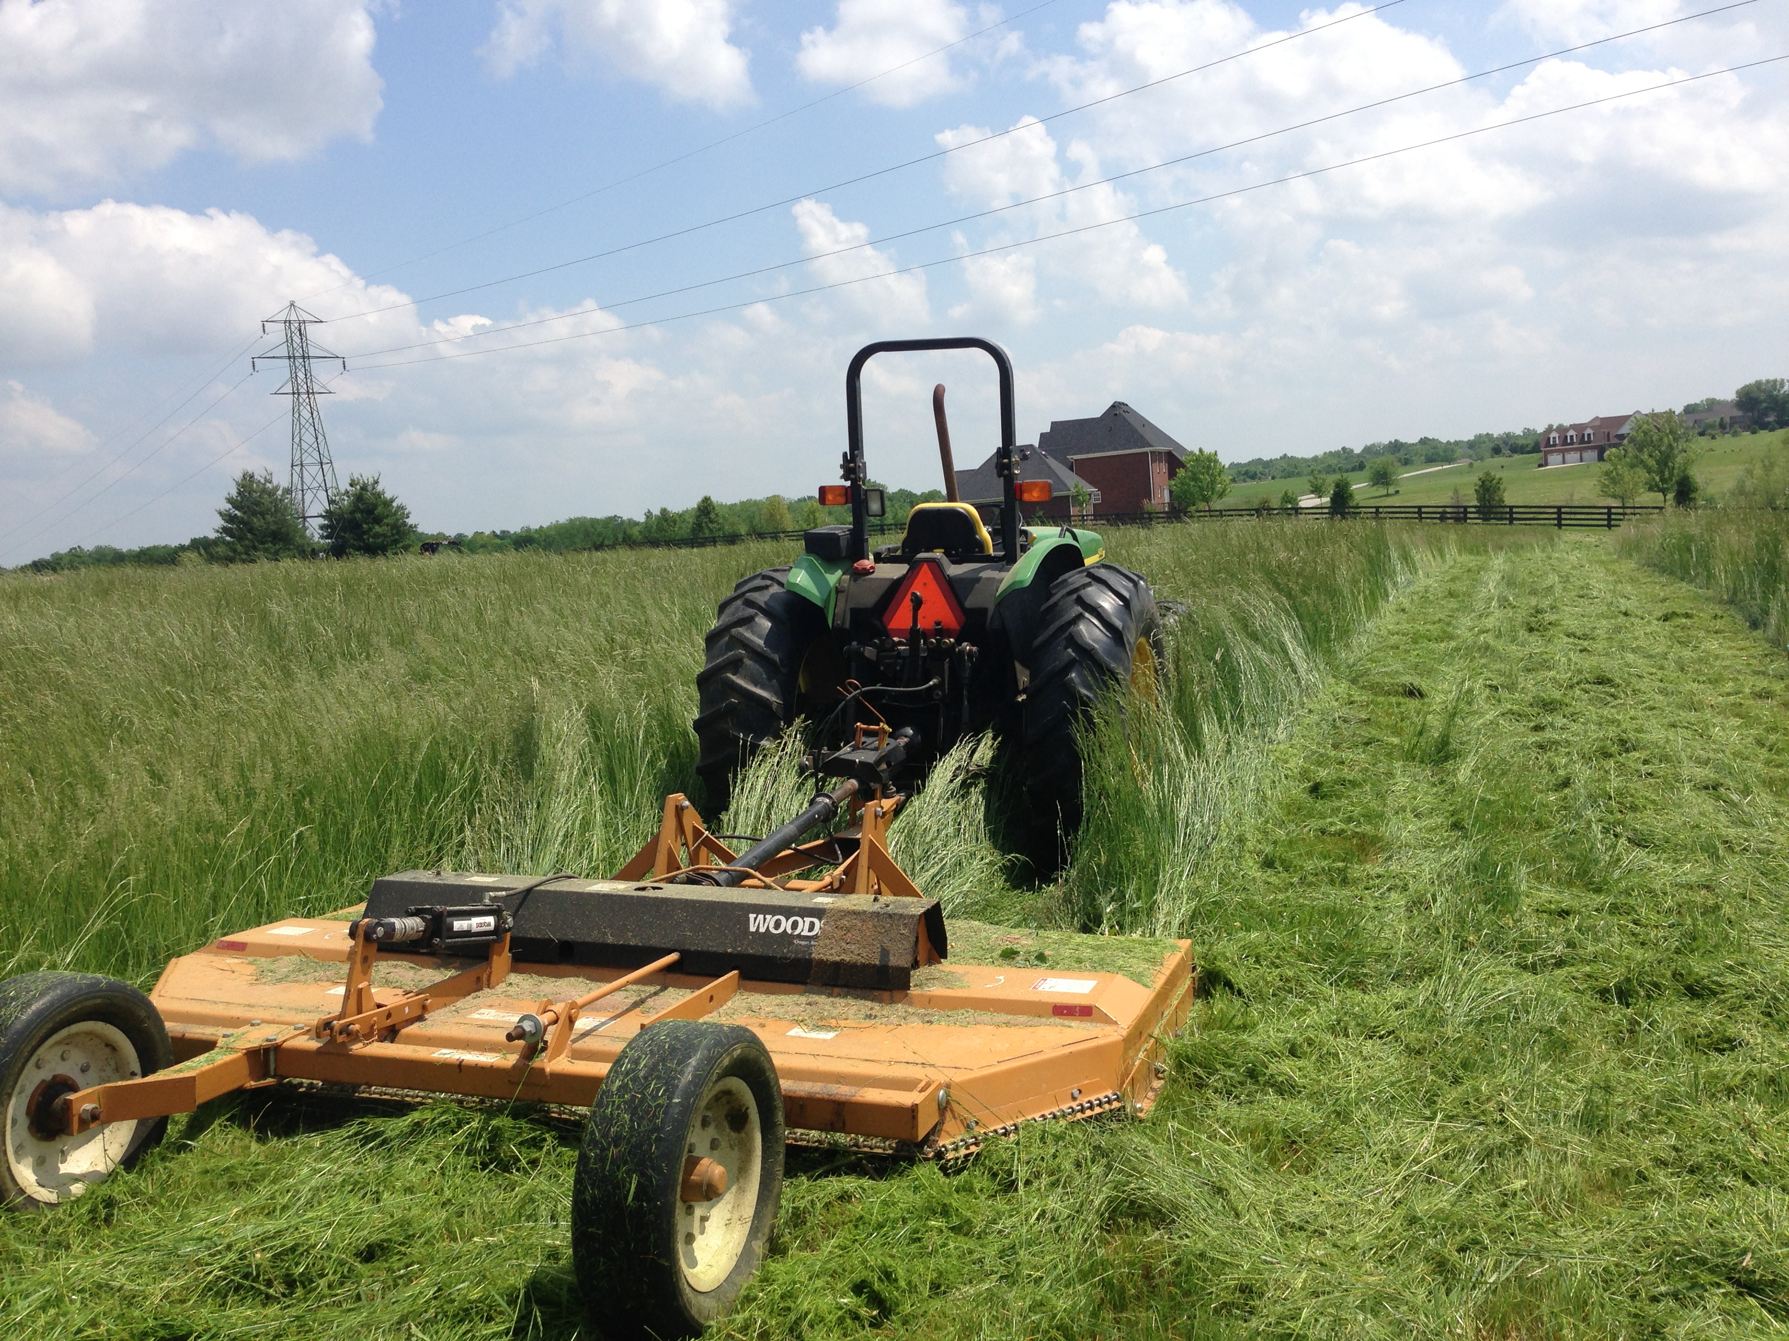
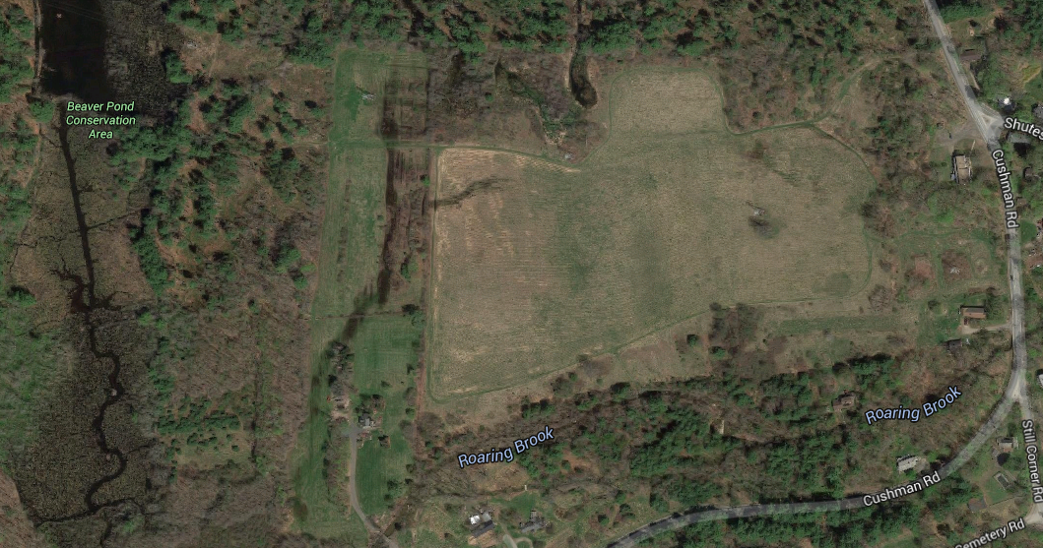
1000 feet

Slide 11
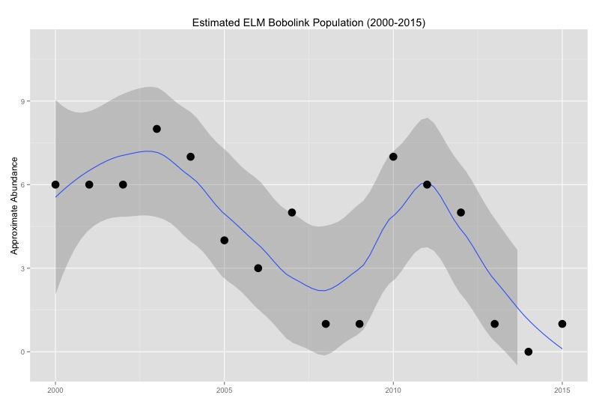
Long-term bobolink survey estimates and significant ELM events

Slide 12
Long-term bobolink survey estimates and significant ELM events
Mowing contract ends

Slide 13
Long-term bobolink survey estimates and significant ELM events
Mowing contract ends
Late season, alternate-year mowing

Slide 14
Long-term bobolink survey estimates and significant ELM events
Mowing contract ends
Field reseeded
Late season, alternate-year mowing

Slide 15
Long-term bobolink survey estimates and significant ELM events
Mowing contract ends
Wood turtles found
Field reseeded
Late season, alternate-year mowing

Slide 16
Long-term bobolink survey estimates and significant ELM events
Mowing contract ends
Wood turtles found
No growing season management
Field reseeded
Late season, alternate-year mowing

